Slide 1

Parcel-level Resilience Scoring at FHSL
Dr. Raenah Bailey

Slide 2
Background
What This Is
A data-driven first assessment of resilience across the Fort Huachuca Sentinel Landscape
Built using nationally, regionally, and locally available datasets and a standardized scoring framework
Designed to identify patterns, strengths, vulnerabilities, and opportunities
What This Is Not
A final product
A replacement for local knowledge
A definitive statement of resilience on the landscape

Slide 3
Why Your Expertise Matters
The Framework Improves Through Collaboration
Local knowledge helps validate results
Better regional datasets can improve accuracy
Missing drivers and stressors can be incorporated
Scoring criteria can be refined to better reflect local conditions
Goal
Create a resilience framework that reflects the realities of Fort Huachuca and supports local decision-making.

Slide 4
The Resilience Scorecard: Local Partner Perspective on Utility & Success in the Camp Ripley Sentinel Landscape
Destiny McDonald – Easement Coordinator
Morrison Soil & Water Conservation District

Slide 5
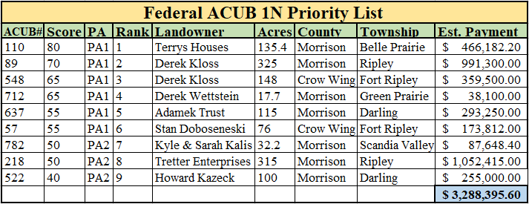
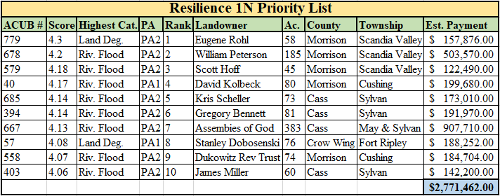
Using the Tool for Program Ranking

Slide 6
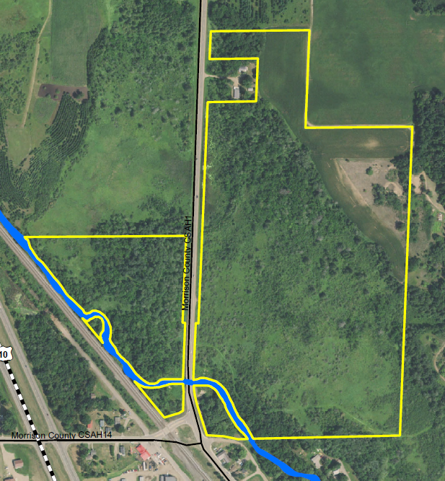
Project Execution
Fischer Parcel
Completed
80.4 acres protected
Mix of agriculture, forest, wetlands, and riparian habitat on the Little Elk Creek

Slide 7
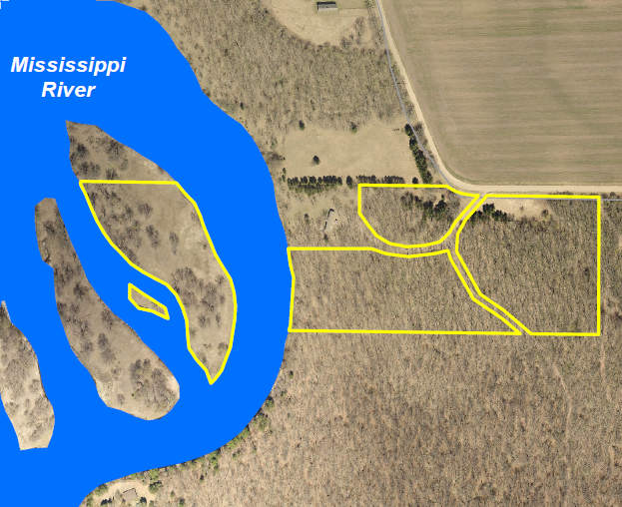
Project Execution
Simonett Parcel
In process
15.4 acres to be protected
Mix of forest and riparian habitat on the Mississippi River

Slide 8
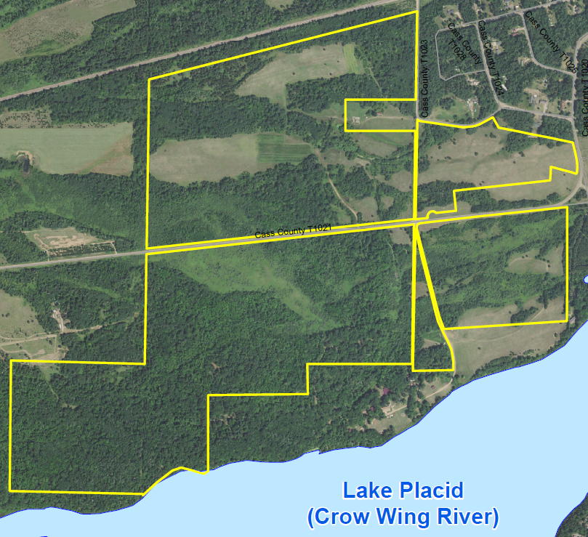
Project Execution
Minnesota District Council of the Assemblies of God
In process
315 acres to be protected over 2 easements
Children’s camp/religious retreat center/ and community event center
Mix of agriculture, forest, wetlands, and riparian habitat on the Crow Wing River

Slide 9
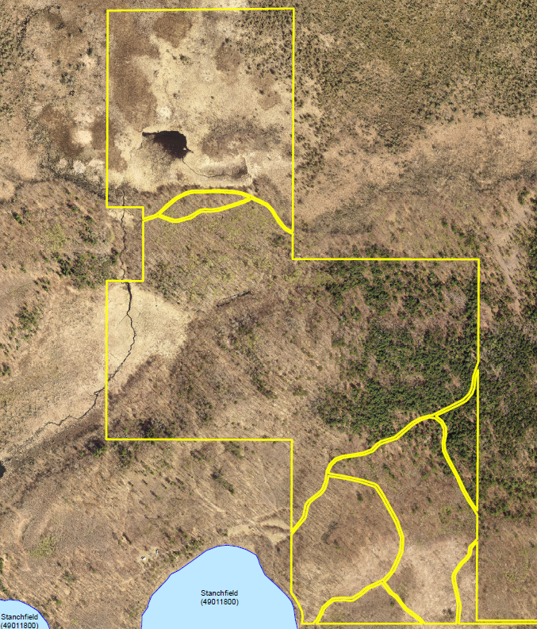
Project Execution
Peterson Parcel
Application in the works
175.6 acres to be protected
Mix of forest, wetland, and riparian habitat on Stanchfield Lake/contributing tributaries

Slide 10
Additional Benefits
Easy to identify resilience metrics at the parcel level and provide justification for funding selections.
Use as a tool to educate landowners on the advantages of protecting and properly managing their property.
Provides opportunities to collaborate, share data, and build relationships with other local conservation organizations.
An excellent resource to include in project proposals and grant applications.

Slide 11

Thank you!

Slide 12
The Anatomy of a Resilience Tool
1. Select hazards to assess
2. Choose metrics linked to resilience
3. Use zonal statistics for parcel scoring
4. Combine scores into composite indices
5. Map patterns to guide decisions

Slide 13
Hazards Evaluated
Drought
Extreme Temperature
Flooding
Wildfire
Land Degradation

Slide 14
Drought Resilience - Methods
Metric | Why It Matters | Priority | Reasoning for Priority
Distance to riparian corridor (San Pedro, Babocomari, GDEs) | Parcels near perennial or seasonally persistent reaches provide cool, moist microclimates, groundwater-dependent habitat, and drought refugia for species and people; they also support evapotranspiration-driven cooling but are highly sensitive to pumping. | High | Core ecological drought resilience and biodiversity metric; central to ESA compliance along the San Pedro Riparian National Conservation Area.
Groundwater decline | Long-term groundwater trends indicate whether aquifers supporting riparian flows and wells are approaching critical thresholds; portions of the Upper San Pedro Basin already exhibit significant declines and recent well failures. | High | Direct link to mission risk, court-ordered water rights, and limits on future development and water security.
Well density | High density of domestic and irrigation wells signals groundwater stress and exurban subdivision, increasing long-term demand and landscape fragmentation. | High | Strong proxy for combined hydrologic and land-use pressure around Fort Huachuca and Sierra Vista.
Recharge zone proximity | Proximity to recharge areas identifies where infiltration sustains alluvial aquifers and baseflow critical to ESA obligations and installation water security. | High | One of the few strong positive resilience factors in an otherwise water-limited system.
Soil infiltration / hydrologic soil group | Soil texture and structure control infiltration versus runoff during monsoon storms; high-infiltration soils support recharge where water is present. | Medium | Important modifier for recharge and flood buffering rather than a stand-alone driver.
Irrigated vs non-irrigated land | Irrigated cropland requires sustained pumping from stressed aquifers, increasing vulnerability to curtailment, while native rangeland is more precipitation-balanced. | Medium | Highly relevant where agriculture overlaps groundwater-decline cones and riparian corridors.

Slide 15
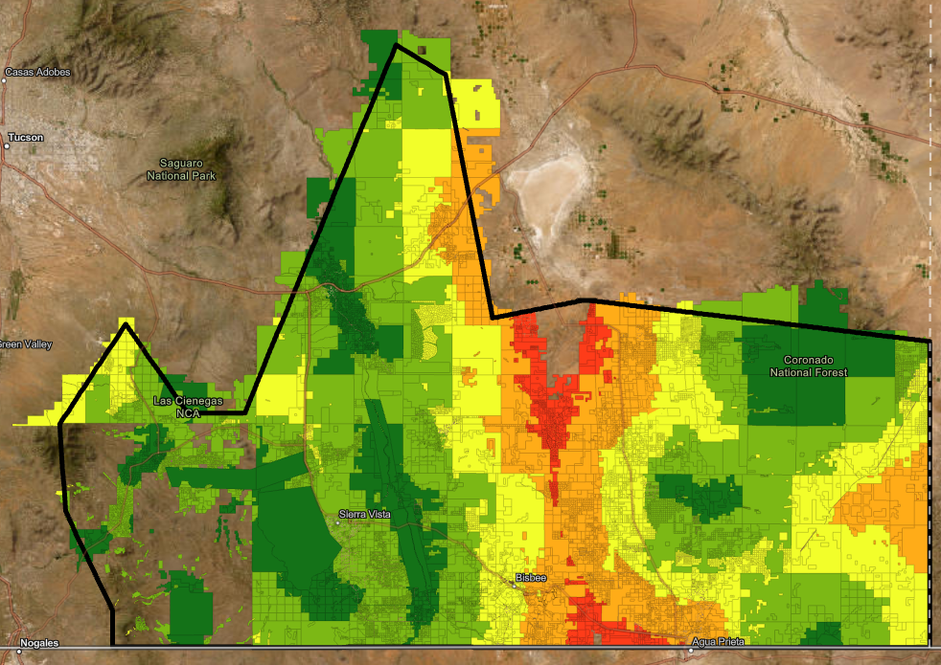
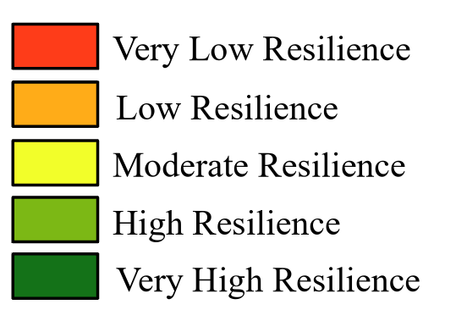
Drought Resilience - Results
Higher Resilience
Concentrated along the San Pedro River corridor and major groundwater-dependent ecosystems
Strong around Las Cienegas National Conservation Area and key recharge landscapes
Present in portions of the Coronado National Forest and mountain-front recharge zones
Associated with riparian habitat, springs, cienegas, and groundwater recharge opportunities
Lower Resilience
Concentrated within portions of the Upper San Pedro Basin experiencing groundwater stress
Associated with higher well densities, groundwater decline, and increased water demand
Most evident in developed and agricultural portions of the landscape
Generally located farther from major water-supporting features and recharge areas

Slide 16
Extreme Temperature - Methods
Metric | Why It Matters | Priority | Reasoning for Priority
Tree and woody canopy cover | Canopy reduces surface and air temperatures, buffers heat stress, and improves microclimate conditions for people and wildlife. | High | Most direct landscape-scale moderator of extreme heat exposure.
Proximity to riparian and perennial water features | Riparian corridors and perennial water bodies provide localized cooling and thermal refugia during extreme heat events. | High | Primary heat-refugia mechanism in arid and semi-arid systems.
Topographic exposure (elevation, slope, aspect) | Elevation and aspect influence solar loading, nighttime cooling, and heat accumulation. | Medium | Important physical control on heat exposure but secondary to vegetation and water.
Vegetation life form / ecological unit | Different vegetation structures vary in heat tolerance and shading capacity. | Medium | Provides ecological context and avoids over-reliance on generic land cover.

Slide 17
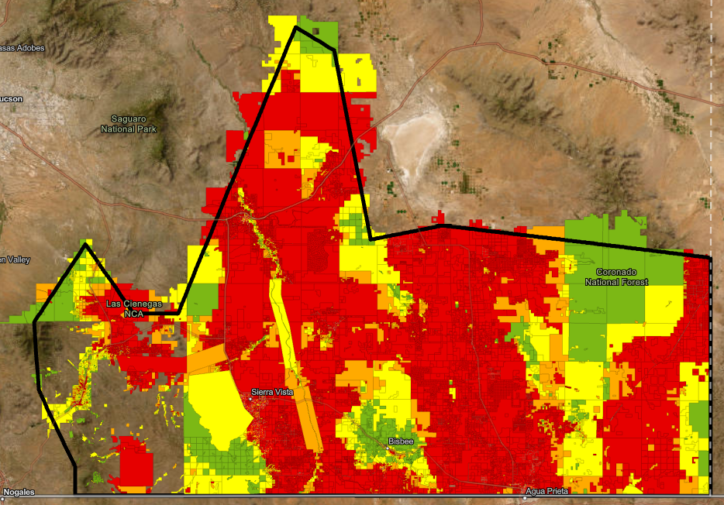
Extreme Temperature - Results
Higher Resilience
Concentrated in higher-elevation mountain environments and foothills
Strong within portions of the Coronado National Forest
Associated with greater vegetation cover, cooler temperatures, and topographic relief
Highlights the importance of natural thermal refugia across the landscape
Lower Resilience
Widespread across the basin floor and developed valley environments
Associated with lower elevations, limited shade, and reduced cooling opportunities
Elevated heat exposure away from major water features and mountain systems
Las Cienegas results suggest opportunities to refine datasets and better represent local cooling functions

Slide 18
Wildfire - Methods
Metric | Why It Matters | Priority | Reasoning for Priority
Risk to Potential Structures (Risk to Homes) | Integrates wildfire likelihood, intensity, and generalized consequences to structures. | High | Most policy-relevant and defensible wildfire risk metric available nationally.
Conditional Risk to Potential Structures | Separates consequence from probability, identifying where fire would be most damaging if it occurs. | High | Critical for understanding exposure severity independent of ignition likelihood.
Burn Probability (Wildfire Likelihood) | Annual probability of wildfire occurrence at a given location. | High | Core exposure metric independent of development patterns.
Community Wildfire Risk Reduction Zones | Identifies dominant wildfire transmission pathways (direct, indirect, ember-driven). | Medium | Informs mitigation relevance rather than intrinsic hazard.
Flame length metrics (Conditional, 4-ft, 8-ft exceedance) | Flame length indicates fire intensity and suppression difficulty. | Medium | Important intensity signal but correlated with other wildfire metrics.
Wildfire Hazard Potential (WHP) | Identifies areas prone to high-intensity, difficult-to-manage fires. | Medium | Widely used planning index; overlaps with risk and intensity metrics.

Slide 19
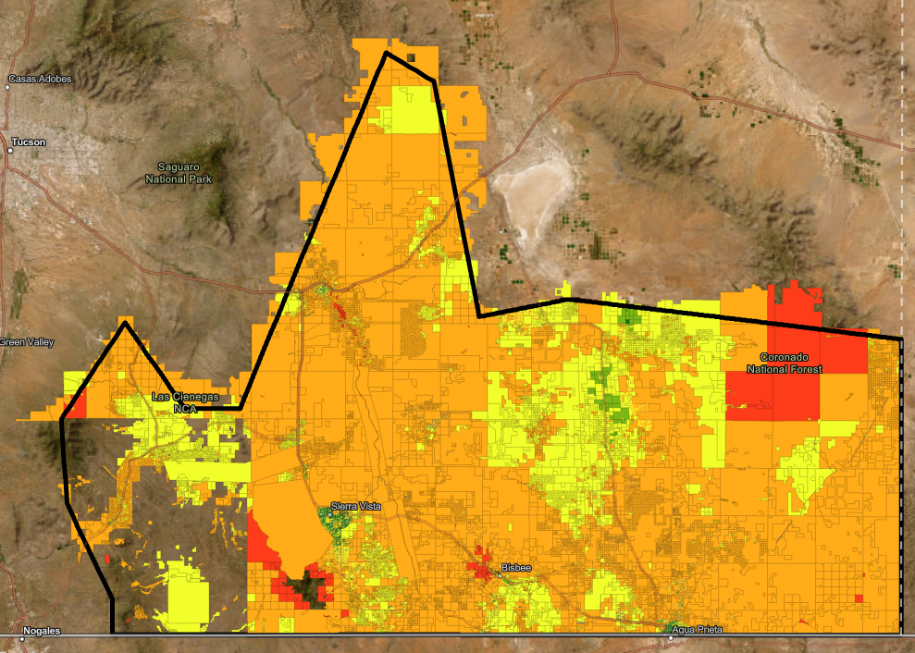
Wildfire - Results
Higher Resilience
Most parcels exhibit moderate to moderately high wildfire resilience
Strongest resilience associated with intact native vegetation and lower development pressure
Many grassland, shrubland, and woodland systems remain adapted to periodic fire
Demonstrates the ecological role of wildfire across the landscape
Lower Resilience
Localized hotspots where wildfire hazard overlaps with development and infrastructure
Concentrated near portions of the wildland-urban interface
Associated with elevated structural exposure and wildfire consequences
Highlights areas where fuels management and preparedness efforts may provide the greatest benefit

Slide 20
Key Takeaways
Resilience is strongly tied to ecological function. Water resources, thermal refugia, and healthy fire-adapted ecosystems consistently emerged as important resilience drivers across all three hazards.
Water is foundational to landscape resilience. Riparian corridors, groundwater-dependent ecosystems, recharge areas, and perennial water features repeatedly appeared as important contributors to both drought and extreme temperature resilience.
The landscape contains important natural refugia. The San Pedro River corridor, Las Cienegas region, mountain environments, and portions of the Coronado National Forest provide critical resilience benefits across multiple hazards.
Wildfire resilience differs from drought and heat resilience. Fire is a natural ecological process in this landscape, and the prevalence of moderate resilience suggests many areas retain characteristics that allow them to coexist with periodic wildfire.
This is a starting point, not an endpoint. These first-pass results provide a baseline for discussion and can be strengthened through local expertise, additional datasets, and refinement of scoring assumptions.

